Slide 1

Assignment 7 - California Housing
297107 - Fatema Ataii
293167 - Pawel Skrzypkowski
299111 - Mihail Alexandru Teodosiu
285041 - Matey Dimitrov Matev
Notes:
Welcome to the presentation of last machine learning assignment. The topic picked by the group is the california housing dataset.

Slide 2
Agenda
Understanding the problem and forming an objective
Why the group’s solution achieves the business objective
What worked and what did not
Model’s limitations
Notes:
Agenda is :

Slide 3
Understanding the problem and forming an objective
Problem : Predicting the price of a house
Objective : To develop a model that can predict the sale price of a house based on its characteristics, such as size, location, and number of bedrooms. This will help real estate agents to better understand the market and make more accurate pricing recommendations to their clients.

Slide 4
Frame,
Performance measurement
Framing : This problem can be framed as a supervised learning task, as we have a dataset of houses with their characteristics and sale prices, which can be used to train the model.
Performance measurement: The performance of the model can be measured using metrics such as mean absolute error and mean squared error, which can help to evaluate how closely the predicted prices match the actual sale prices.
Notes:
(Matey) – To have better understanding of the big picutre better we frame the problem and measure the performance of models.

Slide 5
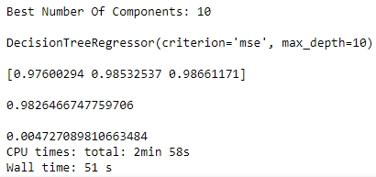

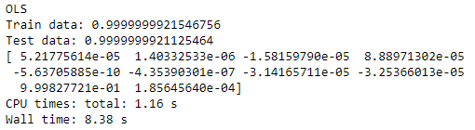
Why presented solution achieves the business objective
The presented solution achieves the business objective of predicting housing prices because algorithms are able to analyze large amounts of data and identify patterns and trends that can be used to make accurate predictions. This allows the solution to provide accurate and reliable predictions that can help businesses make informed decisions about the housing market. Additionally, algorithms are able to continually learn and improve over time, making them an effective tool for predicting housing prices.

Slide 6
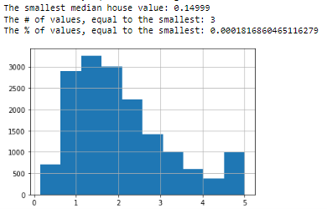
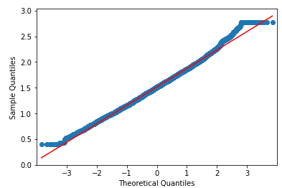
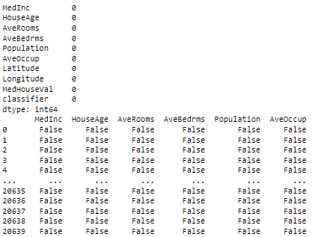
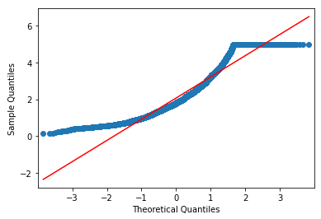
What worked and what did not
Notes:
Form what the group experienced during execution of the assignment:
the cleaning and preprocessing of the data was successful, as well as the implementation of normality tests and scaling of features.
However, it appears that some of the models are overfitting, which means they are performing well on the training data but not as well on new or unseen data. This can happen when a model is too complex and has too many parameters, which can cause it to memorize the training data instead of learning the underlying patterns. To address this issue, the group tried using techniques to reduce overfitting, such as using early stop to prevent the model from becoming too complex and also tried using simpler models. We have tried as well reducing the number of features but we couldn’t succeed much in it. (Matey) - Now I give the word to “Next”

Slide 7
Model’s limitations
Models:
Linear Regression
Overfitting tendencies
Complicated optimization
Random Forest
Creates a lot of trees and combines their outputs, too complex
Requires longer training period
Decision Tree Regression
Cannot be used well with continuous numerical variables.
Small change in data tends to cause a big difference in the tree structure (instability)
Notes:
the models used in the assignment are to complex therefore they tend to overfit for example the Linear regression and Decision Tree Forest. On the other hand Random forest needs time to actually starts producing good results.

Slide 8
The End

